Slide 1

Demand-Side Policy
MONETARY POLICY
3.5
Copyright Bananaomics

Slide 2


Definition
Monetary Policy
Monetary = Money
The activities conducted by a central bank using the money supply and interest rates to regulate an economy.
Copyright Bananaomics

Slide 3

Definition
Central Bank
A national bank of a country that controls the money supply using monetary policy and manages the domestic currency.
Copyright Bananaomics

Slide 4


Definition
Money Supply
The total amount of money in circulation in an economy.
Copyright Bananaomics

Slide 5

Central Bank Functions
  Determines the money supply and interest rate
  Prints money and mints coins
  'Last Resort' lender for commercial banks
  Open Market Operations (Buying/Selling Bonds)
  Regulates the banking system (Required Reserve Ratio)
Copyright Bananaomics

Slide 6
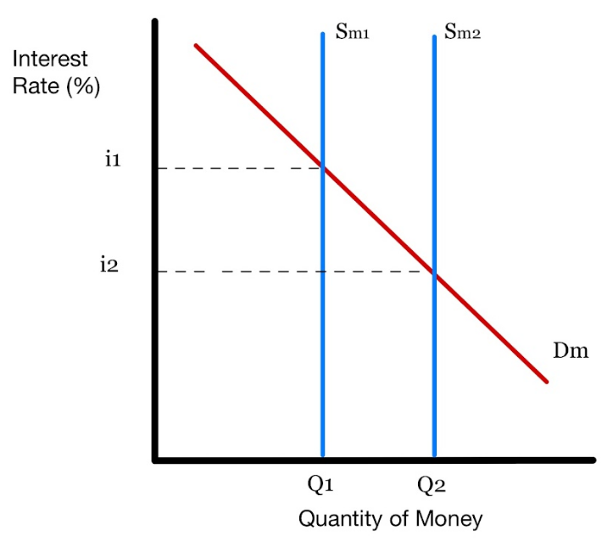
  Determines Money Supply and Interest Rate
There is only a certain amount of money available in an economy therefore, the supply of the money supply is fixed or perfectly inelastic. (Sm)
A nation's central bank can choose to intervene and increase the total money supply in an economy.
The relationship between the quantity of money and interest rate is INVERSE. A lower interest rate and increased money supply are designed to stimulate the economy.
This Monetary Policy is used to increase both Consumption and Investment, increasing AD
Copyright Bananaomics

Slide 7

2. Prints Money and Mints Coins
The Central Bank is in charge of printing banknotes and minting coins.
This gives them the ability to :
  control the money supply
  replace old or illegible banknotes
  regulate counterfeit notes by implementing security features within the notes.
Copyright Bananaomics

Slide 8

3. 'Last Resort' Lender for Commercial Banks
If consumers lose confidence in the banking system, everyone will rush to take out their money (known as a ' run on the bank' ) .
Banks will not have this money on hand and therefore, run out of money very quickly.
In this scenario, a central bank typically guarantees deposits up to a certain amount. Additionally, it may step in and limit withdrawal amounts, close banks, or give loans.
The run on the bank from 'It's A Wonderful Life'.
Copyright Bananaomics

Slide 9

4. Open Market Operations (Buying/Selling Bonds)
Bond - A way for the government to raise fun by asking for a 'loan' from individuals. After a predetermined amount of time, the government repays the loan with interest.
Buying bonds takes money out of circulation and into the hands of the government while selling bonds increases the money supply.
Copyright Bananaomics

Slide 10

5. Regulates the banking system (Required Reserve Ratio)
The central bank also ensures that commercial banks don't take on too much risk. To enforce this, the central bank uses the Required Reserve Ratio (RRR).
The RRR is a percentage or portion of deposits that must be kept readily available in reserves.
Copyright Bananaomics

Slide 11
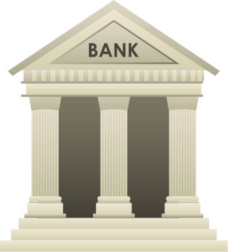
The Goals of Monetary Policy
Copyright Bananaomics

Slide 12

Goals of Monetary Policy
Low and Stable Inflation
With the use of an inflation target range, inflation is managed and creates a sense of certainty within an economy. Inflation should be low and stable.
Low Unemployment
Consumption is the dominant component of GDP. Individuals who are unemployed do not contribute to a country's GDP and will limit consumption.
Copyright Bananaomics

Slide 13


Goals of Monetary Policy
Long Term Growth and Stability
Through careful monitoring of inflation, unemployment, and the business cycle, Real GDP has the ability to grow with stability.
Reducing Business Cycle Fluctuations
Business Cycle fluctuations can heavily impact an economy. Central Bank's have the ability to limit the severity of these fluctuations by using Monetary Policy.
External Balance
External Balance is achieved when imports = exports. Changes to the Money Supply and Interest Rates have the ability to affect external balance and trade.
Copyright Bananaomics

Slide 14

Money Creation (HL Only)
Copyright Bananaomics

Slide 15
Creation of Money
Commercial banks have the ability to create money through loans and credit. Banks are only required to keep the RRR. The remaining amount of deposits may be loaned out.
Example
  JinWoo deposits 100,000 Korean Won at his bank.
  The Required Reserve Ratio (RRR) is set by the central bank at 10%.
  The bank must keep 10,000 Won on hand but can loan out the remainder of 90,000 KRW.
  YuJin, a restaurant owner takes the 90,000 Won loan to buy supplies for their restaurant.
By doing this, a commercial bank has turned 100,000 KRW in circulation to 190,000 KRW by using credit creation.
This process is a chain reaction. JinWoo deposits money and makes credit available. Then YuJin deposits the money from her loan and the rest is credit available. Then someone else receives a loan from YuJin's deposit.
Copyright Bananaomics

Slide 16

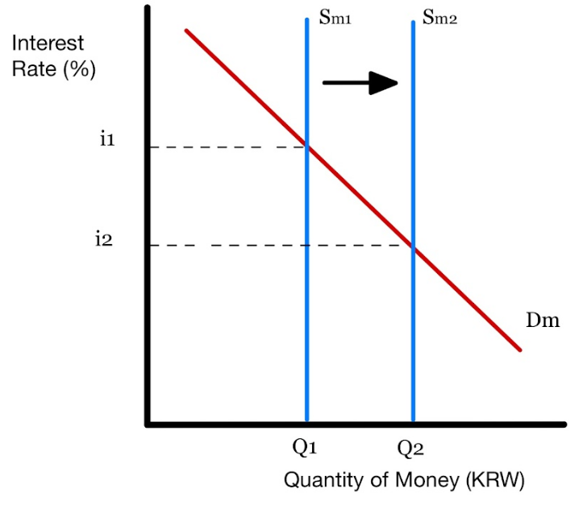


Korean Money Supply Increase
Copyright Bananaomics

Slide 17


Creation of Money
You may need to quickly determine how much money is created with more numbers. To do this, we use the credit multiplier.
Credit Multiplier = the reciprocal of the Reserve Requirement. (10% from our previous example)
Credit Multiplier
RRR
100
10
100
10
x
100
10
100
RRR
100,000 KRW
10
1 Million
KRW
Total Deposits
Initial Deposit
Credit Multiplier
Total Credit Creation
Initial Credit Creation
Credit Multiplier
Initial Credit Creation from our example was 90% of 100,000 KRW.
90,000 KRW
900,000
KRW
10
Please keep in mind these calculations are not required. They are simply here to add to understanding about the process of credit creation.
Copyright Bananaomics

Slide 18

Practice
Please keep in mind these calculations are not required. They are simply here to add to understanding about the process of credit creation.
Lisa makes a deposit of 1,000 Euros at a bank where the Required Reserve Ratio is 5%. Calculate the following:
  Credit Multiplier
  Total Deposits
  Total Credit Creation
Copyright Bananaomics

Slide 19
Practice
Lisa makes a deposit of 1,000 Euros at a bank where the Required Reserve Ratio is 5%. Calculate the following:
  Credit Multiplier
  Total Deposits
  Total Credit Creation
20
20, 000 Euros
19, 000 Euros
Copyright Bananaomics

Slide 20
Review
Money Multiplier/Credit Multiplier Video
Copyright Bananaomics

Slide 21

Tools of Monetary Policy
(HL Only)
Copyright Bananaomics

Slide 22




Monetary Policy Toolbox
Open Market Operations
Minimum Required Reserve Ratio
Minimum Lending Rate / Interest Rate
Quantitative Easing
Copyright Bananaomics

Slide 23


Monetary Policy Tools
Open Market Operations
The interaction between a government and an investor where the government provides an IOU (I owe you) to individuals with interest. The process of buying and selling bonds can impact the money supply.
Reserve Requirements
We should already be famililar with this. If the RRR increases, less money goes into circulation leading to a decrease in the money supply and vice versa.
A fall in the RRR is an expansionary policy as the goal is to increase money in circulation and stimulate the economy. An increase in the RRR is an contractionary policy as the goal is to decrease money in circulation and reduce loanable funds.
Copyright Bananaomics

Slide 24

Monetary Policy Tools
Minimum Lending Rate
The minimum lending rate is the rate at which the central bank charges commercial banks to borrow money. This rate impacts commercial banks interest rates and has the ability to encourage or discourage borrowing money.
Quantitative Easing
When the central bank injects or creates more digital money. Typically, central banks buy bonds with this newly created money which introduces money into the economy. The goal of quantitative easing is to encourage spending and investment in an economy. The opposite to quantitative easing and quantitative tightening where the central bank destroys digitally created money.
Copyright Bananaomics

Slide 25

Monetary Policy Tools
Expansionary Monetary Policy
Contractionary Monetary Policy
  Buying Bonds
  Lowering Reserve Requirement (RRR)
  Lowering Lending Rates
  Quantitative Easing
  Selling Bonds
  Raising the Reserve Requirement (RRR)
  Raising Interest Rates
  Quantitative Tightening
Copyright Bananaomics

Slide 26
Practice
Draw a large business cycle. On the business cycle, label the location where expansionary and contractionary monetary policy would be used. Outline the details of each policy.
Copyright Bananaomics

Slide 27

Demand and Supply of Money
(HL Only)
Copyright Bananaomics

Slide 28
Money Supply and Interest Rate
Interest Rate
The cost of borrowing money.
Money Supply Graph
Y-Axis = The price of money. (interest rate)
X-Axis = The quantity of money
Copyright Bananaomics

Slide 29

Money Supply and Interest Rate
The Supply for Money
The total amount of money in circulation. The supply of money is influenced by monetary policy.
The Demand for Money
The willingness and ability of firms and consumers to use money at a given interest rate. The curve is downward sloping.
What influences the demand for money?
  Transactions Motive: Individuals demand money for physical goods and services.
  Precautionary Motive: Individuals demand money as a precaution for unexpected costs. (medical bills)
  Speculative Motive: Individuals demand money because they want to hold it due to low confidence regarding the future.
Copyright Bananaomics

Slide 30
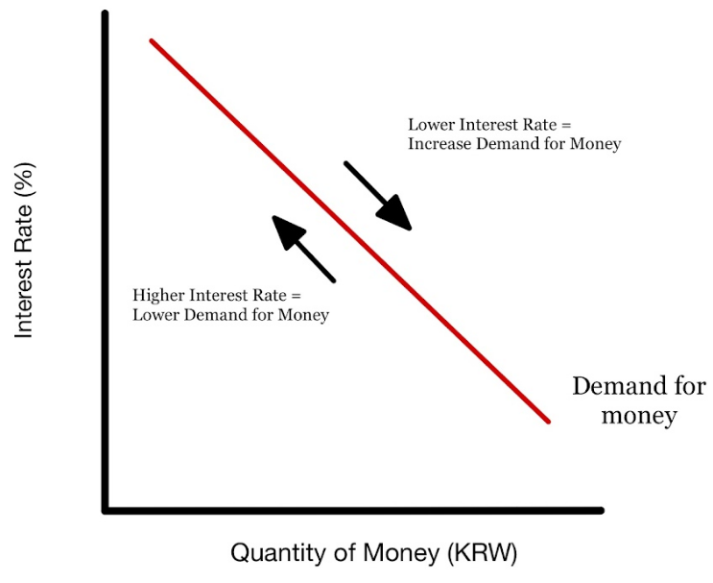
Money Supply and Interest Rate
Copyright Bananaomics

Slide 31
Interest Rates and The Central Banks
How does raising interest rates control inflation? | The Economist
Copyright Bananaomics

Slide 32

Nominal vs Real Interest Rates
Copyright Bananaomics

Slide 33
Nominal vs Real
Nominal Interest Rate
Real Interest Rate
The interest rate quoted by banks that does not include inflation adjustments.
An interest rate with inflation taken into account.
Approximate Formula
Real Interest Rate
nominal interest rate - inflation rate
(1 + nominal interest rate)
Real Interest Rate
Formula for larger numbers
1 + real interest rate
(1 + inflation rate)
Copyright Bananaomics

Slide 34
Practice
Nominal Interest Rate: 30%
Inflation Rate: 5%
Use the approximate method to calculate the real interest rate.
Copyright Bananaomics

Slide 35
Practice
30% - 5% = Real Intrest Rate of 25%.
Copyright Bananaomics

Slide 36
Practice
Real Interest Rate: 10%
Inflation Rate: 10%
Use the approximate method to calculate the NOMINAL interest rate.
Copyright Bananaomics

Slide 37
Practice
10% + 10% = Nominal Intrest Rate of 20%.
Copyright Bananaomics

Slide 38

Expansionary and Contractionary Monetary Policy
Copyright Bananaomics

Slide 39
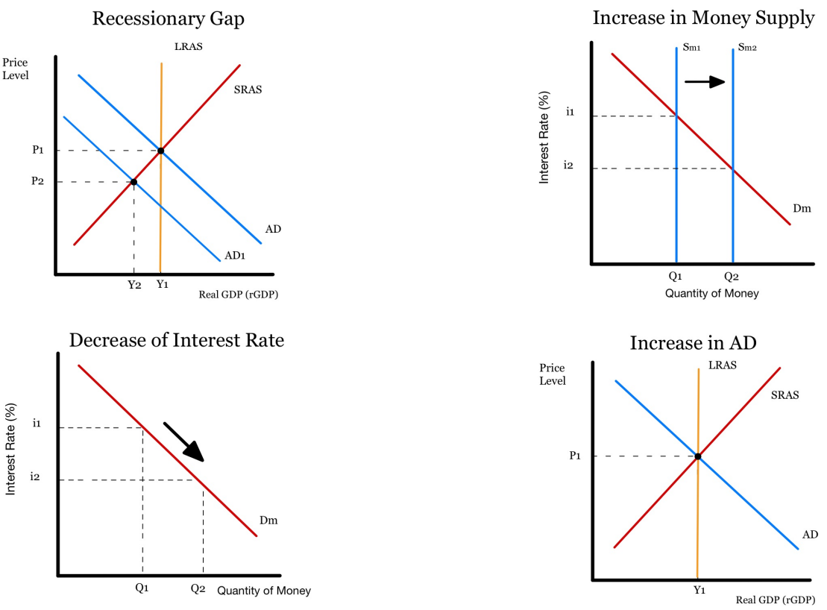




Expansionary Monetary Policy
During a recession . . .
  Recessionary Gap
  Money Supply Increase
  Lower Interest Rate
  Return to Equilibrium
Copyright Bananaomics

Slide 40


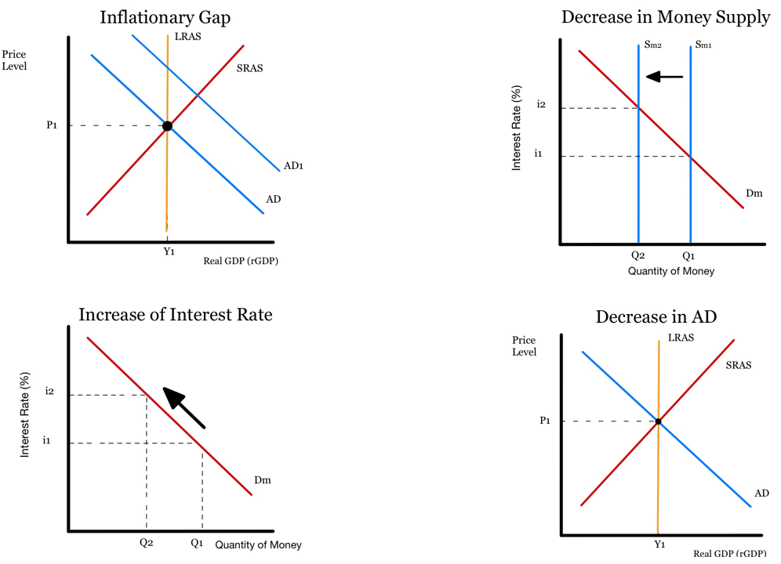


Contractionary Monetary Policy
During an expansion . . .
  Inflationary Gap
  Money Supply Decrease
  Rising Interest Rates
  Return to Equilibrium
Copyright Bananaomics

Slide 41

Effectiveness of Monetary Policy
Copyright Bananaomics

Slide 42

Challenges with Monetary Policy
Low consumer and business confidence
Limited impact of interest rates when already low
Conflict with other government objectives
Copyright Bananaomics

Slide 43

Strengths of Monetary Policy
Short Time Lags
Flexible and Reversable
Copyright Bananaomics

Slide 44

Practice Question
Copyright Bananaomics

Slide 45
Paper 1 Part A
SPEC/3/ECONO/HP1/ENG/TZ0/XX/M
Explain two tools open to a central bank to conduct expansionary monetary policy
Copyright Bananaomics

Slide 46
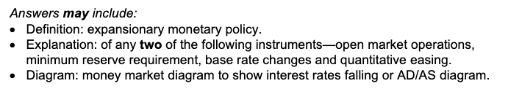
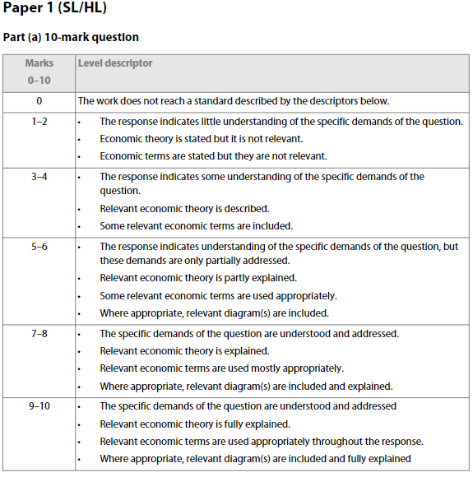
Paper 1 Part A
Copyright Bananaomics

Slide 47
Paper 1 Part A
N15/3/ECONO/HP1/ENG/TZ0/XX
Explain why, using the monetarist/new classical model, the economy will always return to the full employment level of output following a recession.
Copyright Bananaomics

Slide 48

Enjoying The Content?
Visit bananaomics.com to purchase package deals with discount prices!
BANANAOMICS

